Slide 1

Starbucks Capstone Mid Project:
Predicting Customer Response to Offers
Yousef Ismail Ahmed
Data Science Track
Instructor: Mostafa Sabry
December 2025

Slide 2
Business Problem
01
Marketing Inefficiency: Sending generic offers leads to high costs and low engagement.
02
Behavioral Gaps: Difficulty in identifying which customer responds to which offer.
03
The Goal: Optimize targeting by matching offer types to customer demographics and behavior.

Slide 3

Project Objective
Analyze customer demographics and behavior.
Identify engagement patterns across offer types.
Support data-driven offer targeting decisions.

Slide 4
Dataset Overview
Data types:
Numerical (age, income, login_days, etc.)
Categorical (gender, event, offer_type)
Source
Dataset Files:
Starbucks Capstone Dataset (Kaggle)
Number of rows: ~35k, 16 features
Number of columns: 16
3 datasets merged (profile, portfolio, transcript)
profile.csv (customer demographics)
portfolio.csv (offer details)
transcript.csv (customer behavior)

Slide 5



Data Challenges
The dataset presented several challenges that required preprocessing:
Data Cleaning: Resolved the "Age 118" outlier issue and handled missing income values.
Data distributed across multiple files
Missing and inconsistent values
Feature Engineering: Extracted "login_days" from membership dates to measure loyalty.
Created "age_groups" for better categorical analysis.
Some numerical features behaved like categorical variables
Data Integration: Merged Profile, Portfolio, and Transcript into a single modeling-ready dataset.
These challenges required careful cleaning and preparation before analysis.

Slide 6
01
Data Cleaning & Feature Engineering

Slide 7

Designing Effective Questions
Merged all datasets into a single unified dataset
Removed unrealistic age outliers
1
2
3
4
Handled missing and inconsistent values
Created new features
Customer tenure (login_days)
Age groups (age_group)
Membership year, month, and day

Slide 8
02
Exploratory Data Analysis (EDA)

Slide 9
EDA was divided into:
EDA was conducted to understand customer behavior and engagement patterns across different offer types.
Univariate Analysis
Bivariate Analysis
Multivariate Analysis

Slide 10
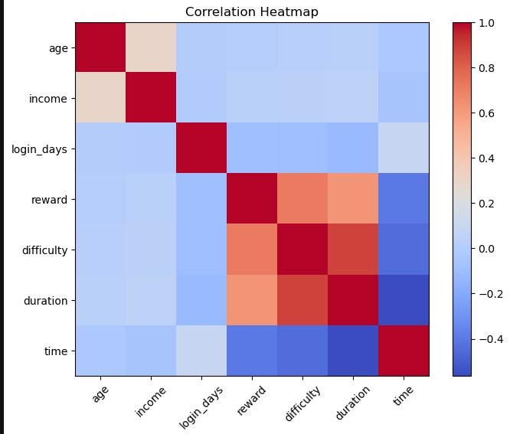
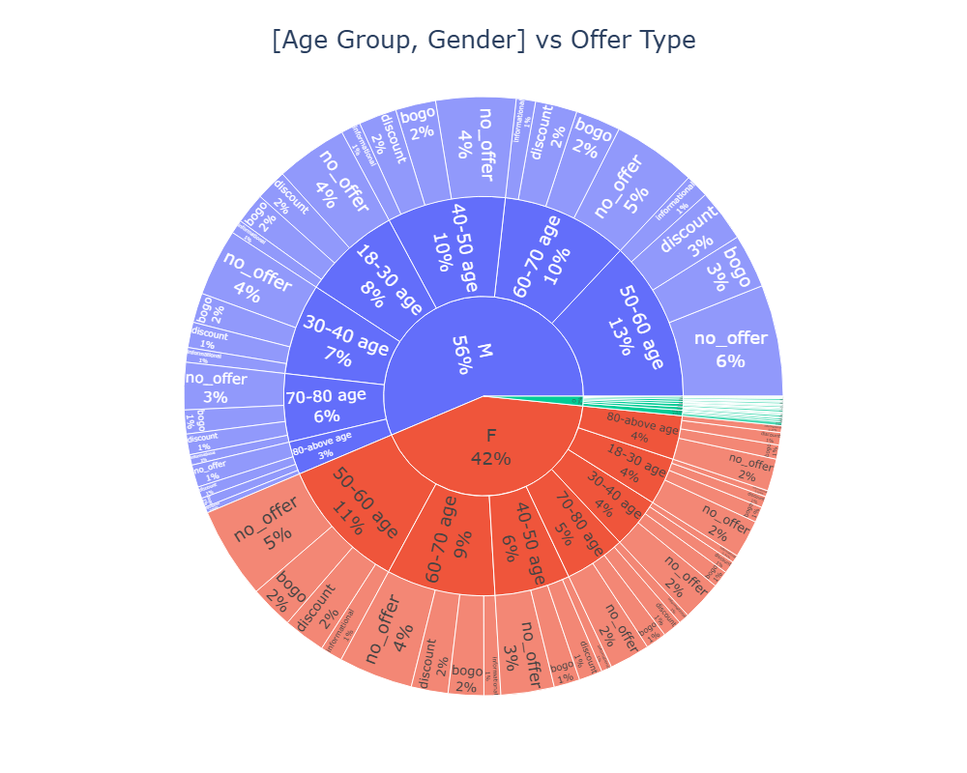
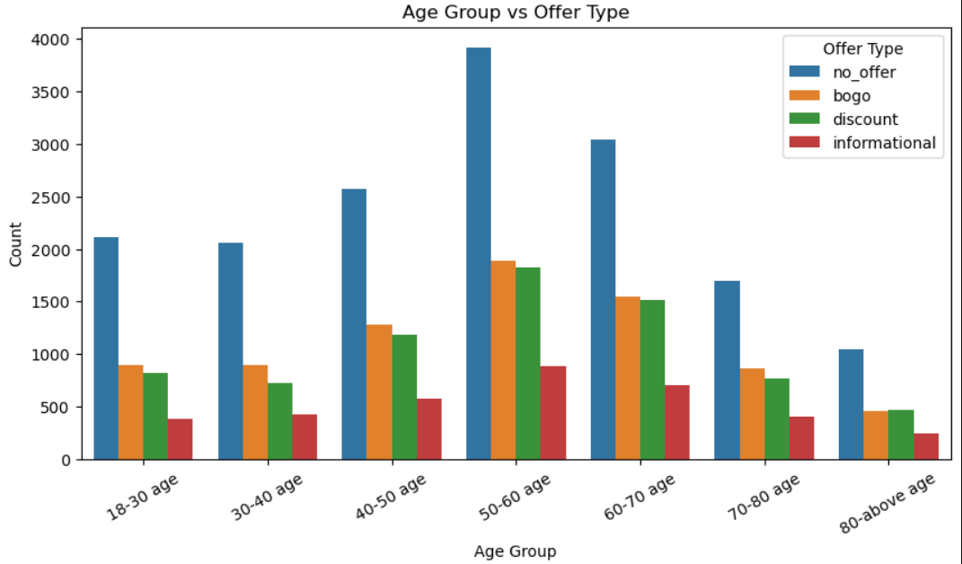
Screens From EDA
Customers aged 50–60 are the most engaged.
BOGO and Discount offers dominate interactions.
Higher income correlates with higher offer exposure.

Slide 11
Streamlit Application
A Streamlit web application was built using Python & Plotly for interactive stakeholder engagement, and developed to demonstrate the project results.
The application allows users to:
1
2
3
Analyze offer engagement across different segments
Demonstrate EDA results in an interactive dashboard
Explore customer demographics and behavior visually
This application demonstrates exploratory analysis and business insights, not real-time prediction.

Slide 12



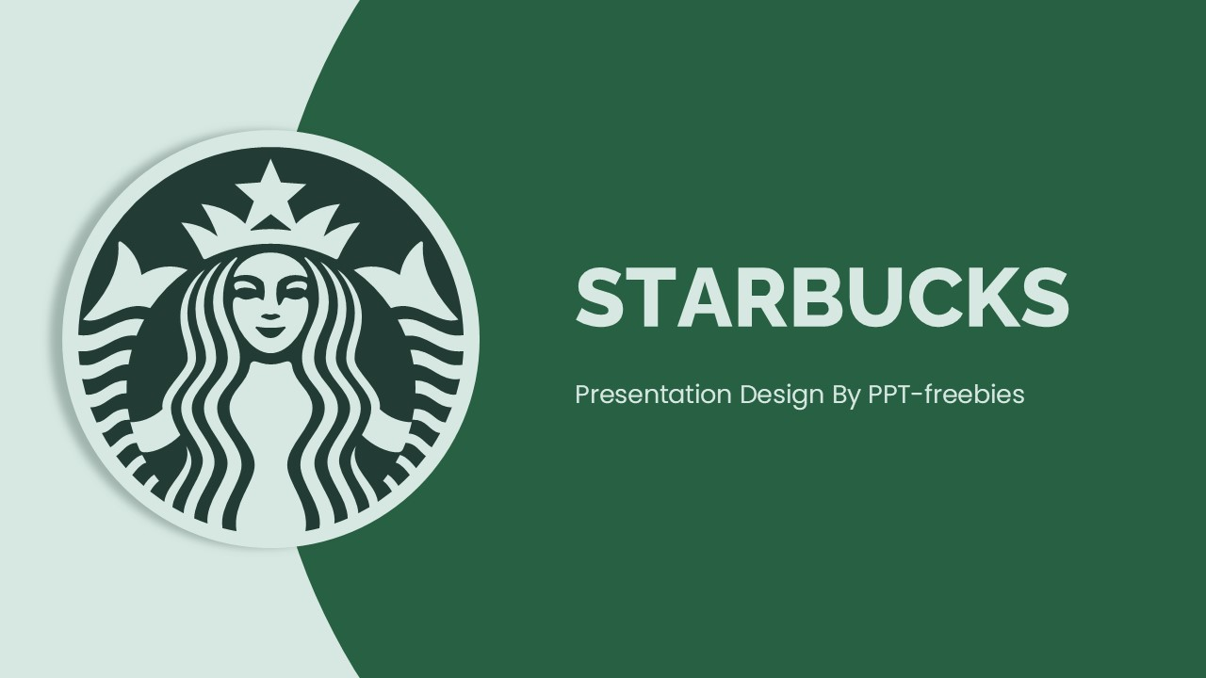




Business Impact from THIS analysis:
1
2
3
4
Highlights the most effective offer types (BOGO & Discount)
Identifies the most engaged age segments (50–60)
Links customer tenure to engagement behavior
Provides insights for personalized offer targeting

Slide 13

Key Insights
The analysis revealed several important insights:
Customers aged between 50 and 60 show the highest engagement.
BOGO and Discount offers dominate customer interactions.
Higher-income customers tend to receive more promotional offers.
Strong correlation exists between reward, difficulty, and duration.
Customer tenure (login_days) positively influences offer engagement.
These insights highlight clear patterns in customer behavior.

Slide 14
Future Roadmap & Phase 2
Model Optimization with Ensembles
Upgrade to advanced ensemble methods, such as Random Forest and LightGBM, and fine-tune models using GridSearch for optimal accuracy.
Enhanced Feature Engineering
Introduce RFM Analysis to improve customer segmentation and gain deeper insights for personalized marketing strategies.
Real-Time Prediction API
Implement a prediction API in Streamlit for delivering dynamic offer recommendations instantly based on user interactions.
A/B Testing Simulations
Use A/B testing simulations to evaluate and compare marketing strategies before full rollout, ensuring effective decision-making.

Slide 15
Conclusion
This project demonstrates how data analysis and machine learning can support smarter marketing decisions.
Data cleaning and EDA revealed strong engagement patterns.
Insights can support personalized marketing strategies.
This framework enables Starbucks to shift from generic broadcasting to personalized, data-driven marketing.

Slide 16


